Slide 1
UNIT 2
HARDWARE, SOFTWARE AND NETWORKS
Types of Computers

Slide 2
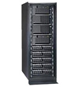
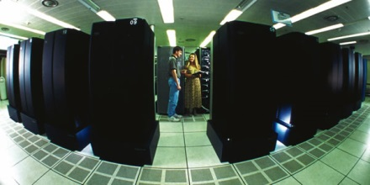
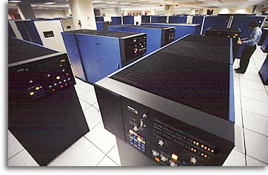
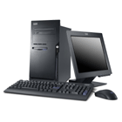

Different Types of Computers
Microcomputers
Minicomputers
Mainframe Computers
Supercomputers
Desktop
Portable

Slide 3

MICROCOMPUTERS
The smallest and the least powerful type of computer
There are 2 types of microcomputers
Desktop
Small enough to fit on top or along the side of a desk
Personal Computer (PC) – Generally thought of as machines designed to run easy to use application software. Widely used at home and office
Workstation – Generally thought of as machines that run more advanced application software. Used by engineers, scientist, and others who process lots of data.
Portable
Small enough to fit in a briefcase or the palm of your hand.
Laptop
Notebook
Subnotebook
Personal Digital Assistant (PDA) – smaller than subnotebooks, also known as handheld PCs.

Slide 4
MINICOMPUTERS
The machine that is bigger than a microcomputer but smaller than a mainframe in their processing speed and storage capability
Also known as midrange computers
Are usually found in medium-size
companies or departments of large
companies
Can be used for general processing tasks, such as accounting, or for specific purposes, such as research or monitoring a particular manufacturing process

Slide 5
MAINFRAMES
Larger computers that are capable of great processing speeds and data storage
Used by large organizations such
as banks, universities, insurance companies
Needs to be located in a specially air-conditioned room

Slide 6
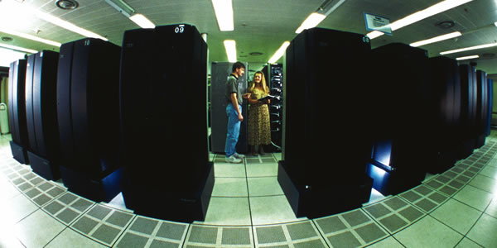
SUPERCOMPUTERS
The largest type of computer in processing power and speed
Are special, high capacity computers
Used by very large organizations
The most powerful type of computer
Are principally used for research projects (NASA, oil exploration, weather forecasting, etc)

